Slide 1

What is IoT
Internet of Things

Slide 2
What is IoT
What is IoT?
IoT Applications
IoT and Data Collection
IoT Connectivity

Slide 3
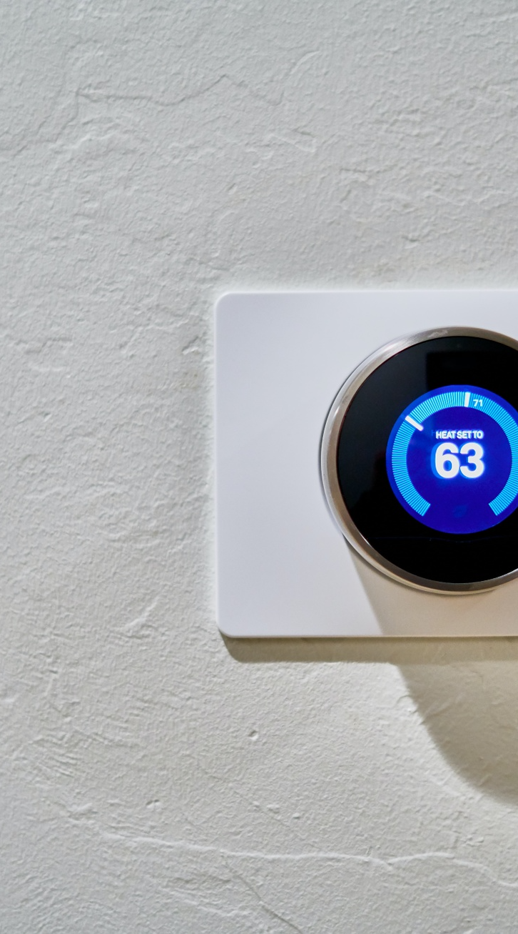
What is IoT?
IoT, or the Internet of Things, refers to the connection of everyday objects, or “things,” to the internet, allowing them to collect, transmit, and share data. This interconnected network of devices transforms previously “dumb” objects, such as toasters or security cameras, into smart devices that can interact with each other and their environment.Every aspect of our lives is soon to be affected. We will experience an unprecedented step-change, on every level – from the way we run our homes and businesses, to how we interact with the cities we live in.

Slide 4
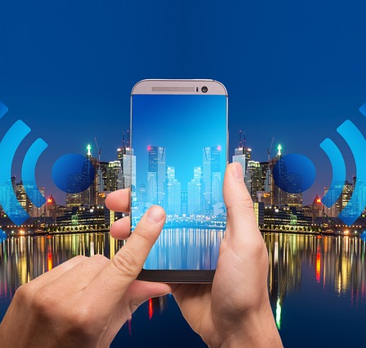
IoT Applications
Smart Cars
Smart City
Smart Home
Smart Business
Smart Industry 4.0

Slide 5
Smart Cars
Advanced Driver Assistance Systems (ADAS)
IoT technology enables various ADAS features such as adaptive cruise control, lane departure warnings, parking assistance, and collision avoidance systems. These features utilize sensors and cameras to gather real-time data about the vehicle's surroundings, helping to improve road safety and enhance the overall driving experience.
Vehicle Telematics
IoT-enabled telematics systems collect and transmit information about a car's performance, location, and usage. This data can be used for remote diagnostics, preventative maintenance, and fleet management. Insurance companies can also use telematics data to offer usage-based insurance policies, rewarding drivers for safe driving habits.
Connected Infotainment Systems
IoT allows cars to connect to the internet, providing drivers and passengers with access to real-time traffic updates, GPS navigation, streaming music, and other multimedia services. Many modern infotainment systems also offer voice command features and smartphone integration, enabling hands-free control of various functions.

Slide 6
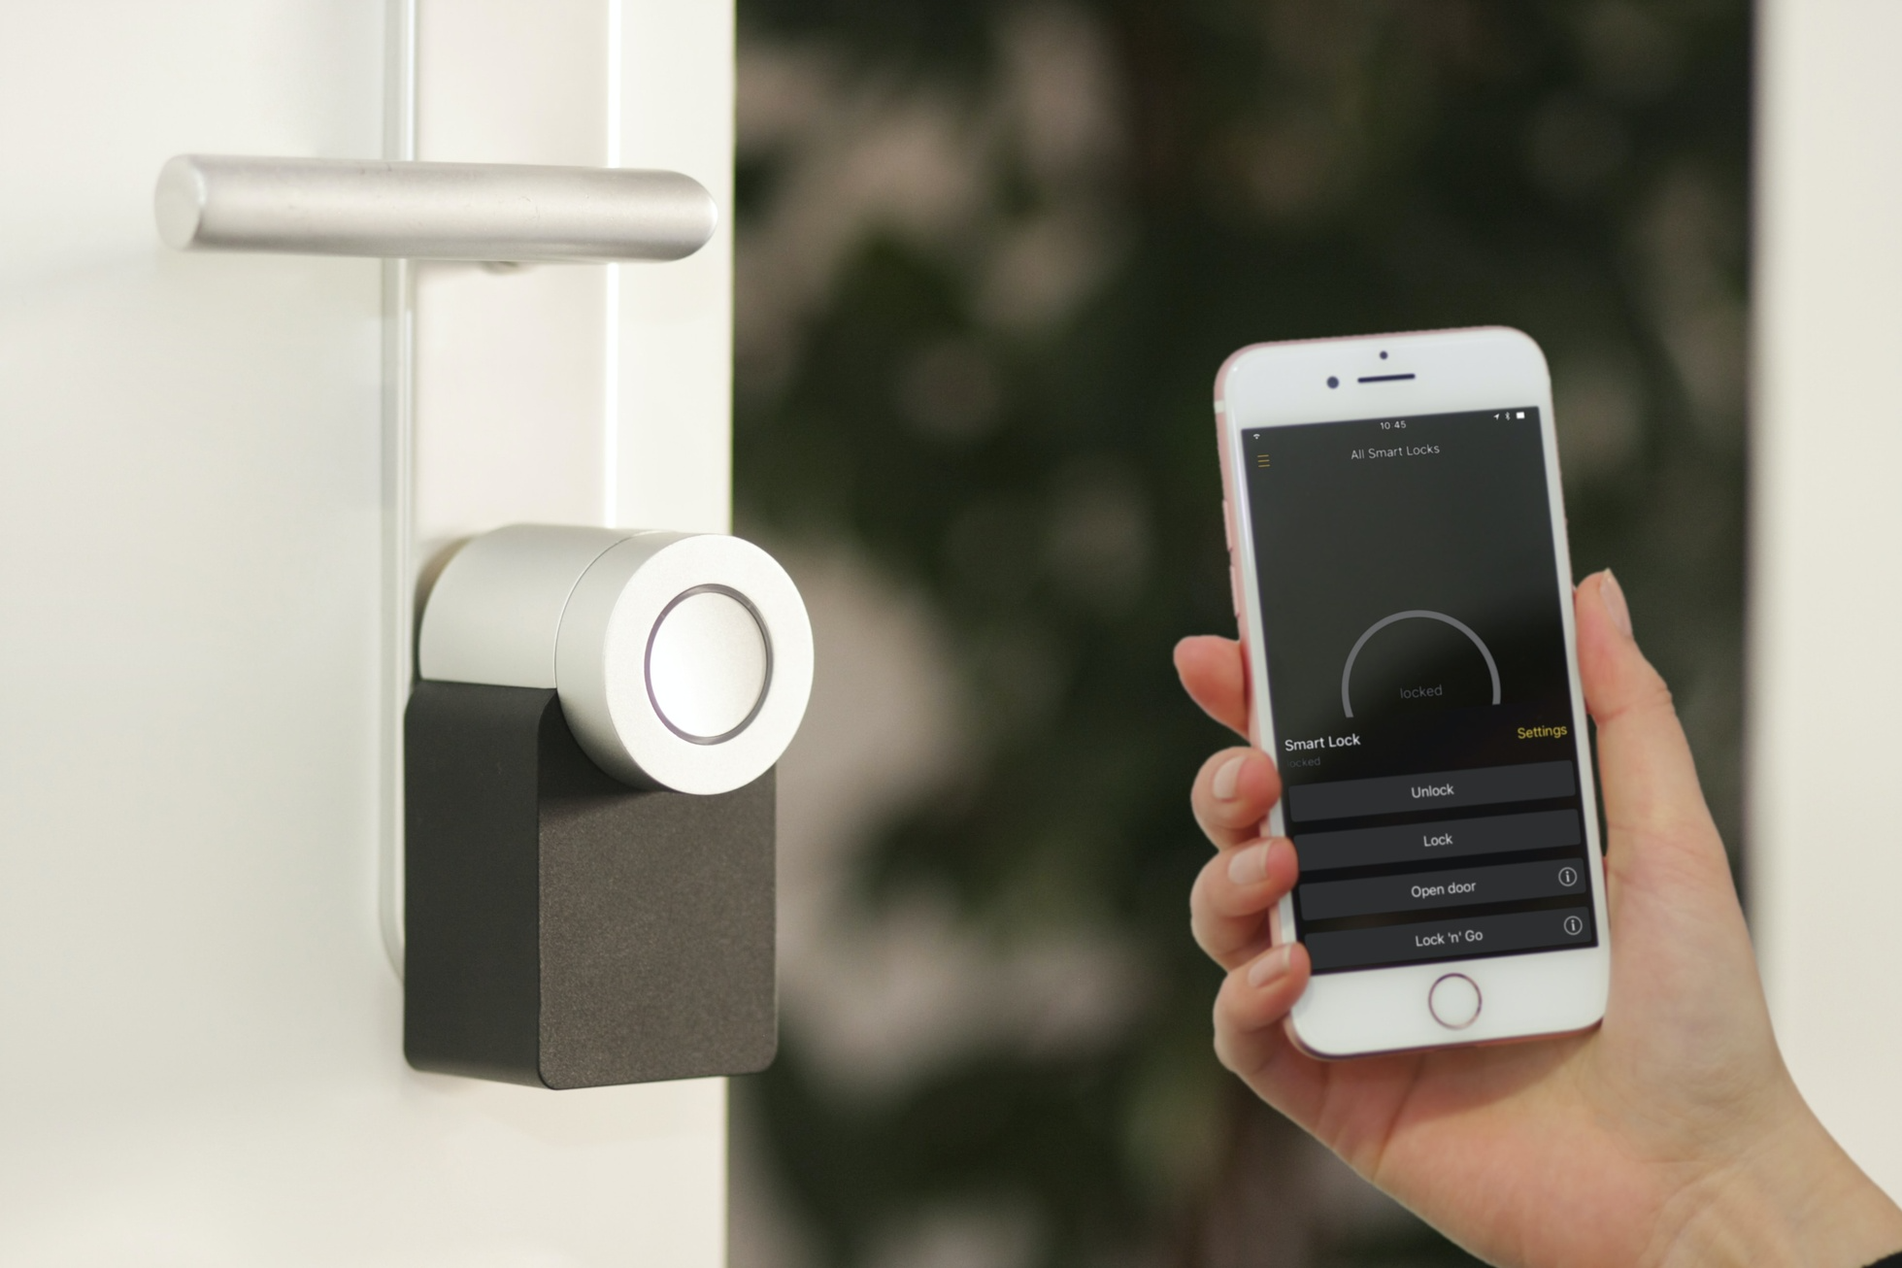
Smart Homes
IoT technology has the potential to revolutionize the way we live by making our homes smarter and more efficient. Examples of IoT applications in our homes include:
Smart thermostats that learn our preferred temperature settings and adjust accordingly
Connected appliances that can be controlled remotely or through voice commands
Home security systems that can be monitored and controlled from our smartphones

Slide 7
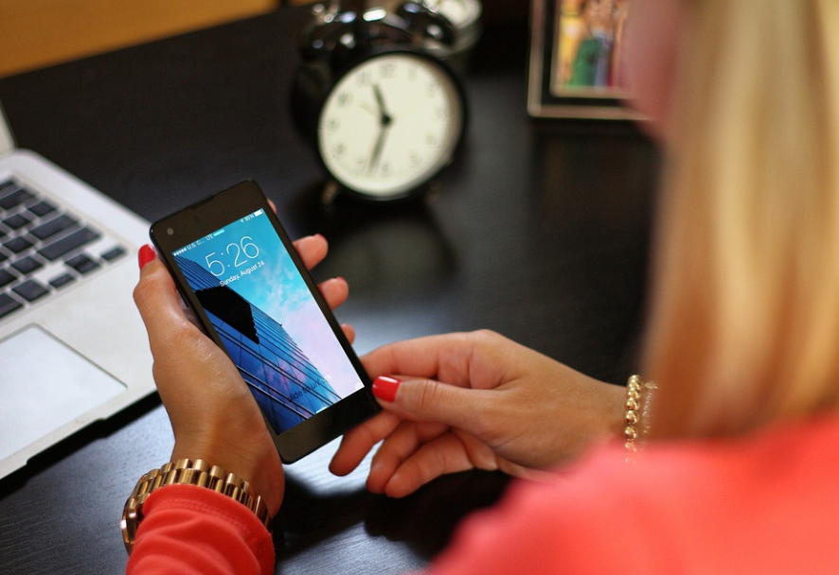
Smart Business
IoT is also transforming the business landscape by streamlining operations, reducing costs, and improving decision-making. Examples of IoT applications in businesses include:
Supply chain and inventory management through real-time tracking of goods
Predictive maintenance for industrial equipment, reducing downtime and maintenance costs
Enhanced customer experiences through personalised marketing and targeted promotions

Slide 8
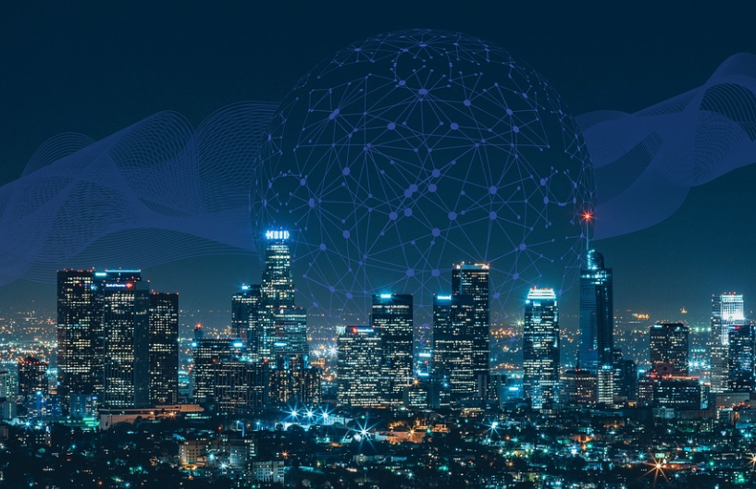
Smart City
By embedding IoT sensors into the infrastructure we use every day, our cities can become cleaner, safer, and more efficient. Examples of IoT applications in cities include:
Smart traffic and public transport management
Intelligent waste management
Environmental monitoring
Smart metering systems for utilities

Slide 9
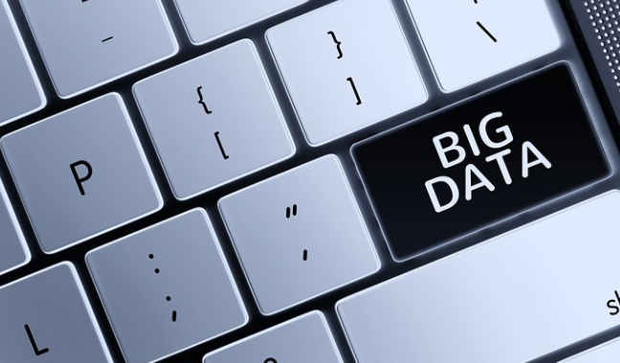
IoT and Data Collection
At its core, IoT is all about data. Smart devices collect and transmit information, which is then analyzed and used to improve performance, user experience, and even sales strategies. As IoT continues to expand, the amount of data collected and analysed will grow exponentially, enabling increasingly personalized and connected experiences.

Slide 10
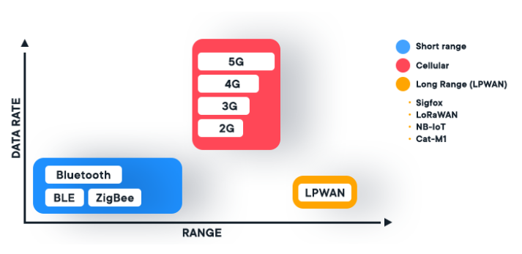
IoT Connectivity
A variety of connectivity options underpin the Internet of Things, including cellular networks, Wi-Fi, and low-power wide-area networks (LPWANs). Each type of connectivity offers different benefits in terms of power consumption, range, and bandwidth. IoT devices often intelligently select the best connectivity option based on their specific needs.

Slide 11
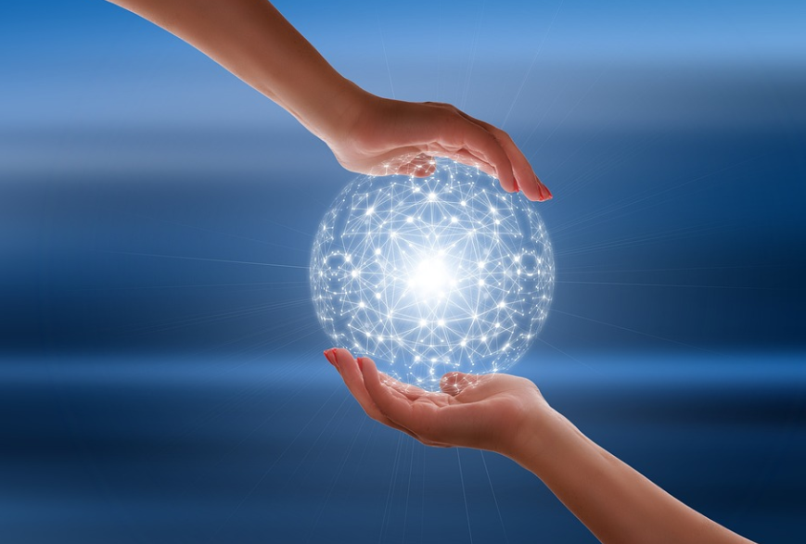
The Future of IoT
While IoT is already impacting our lives in numerous ways, its full potential is yet to be realised.
Businesses that invest in IoT stand to gain in cost efficiencies, streamlined operations, and improved performance analysis.
However, the adoption of IoT also raises questions about data privacy and security as we become more connected than ever before.
Soon everything will be connected.

