Slide 1
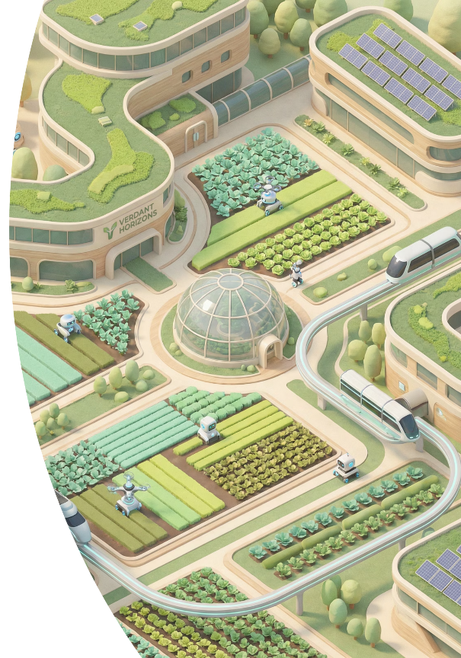
How IoT is Transforming Yields and Optimising Resources in Agriculture
Exploring the revolutionary impact of connected technology on global food production and resource management

Slide 2
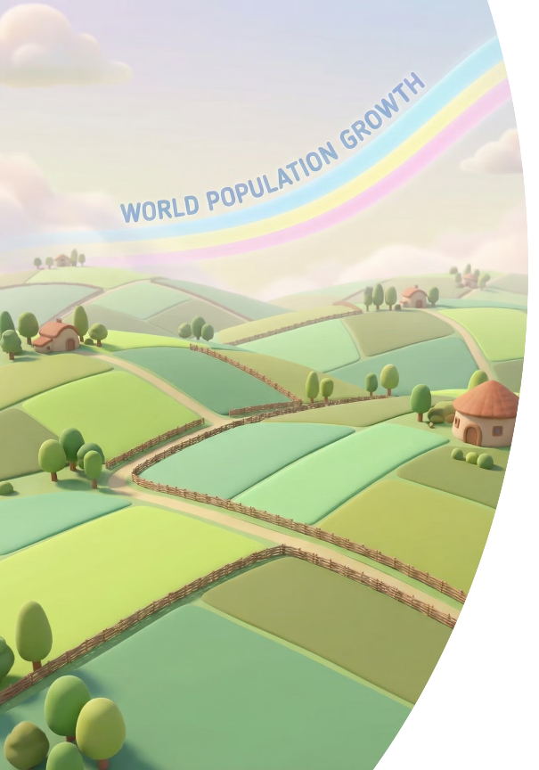
GLOBAL CHALLENGE
The Urgent Challenge Facing Global Agriculture
Population Pressure
Climate & Resources
Global population growth demands 70% more food production by 2050, according to the UN Food and Agriculture Organisation
Climate change, water scarcity, and labour shortages threaten the viability of traditional farming methods
Sustainable Solutions
The need for efficient, sustainable farming solutions has never been more critical for our future

Slide 3

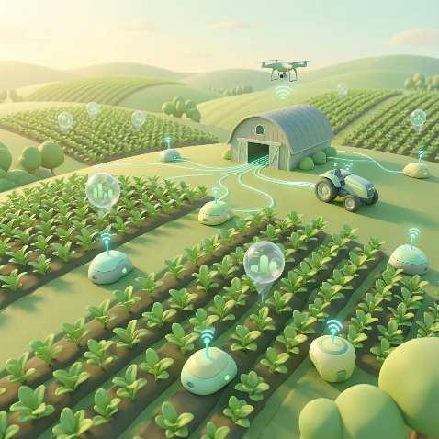
TECHNOLOGY
What is IoT in Agriculture?
The Internet of Things (IoT) in agriculture represents a transformative approach to farming through connected intelligence.
01
Smart Sensing
Network of intelligent sensors and connected equipment deployed across farms
02
Real-Time Monitoring
Continuous tracking of soil conditions, weather patterns, crop health, and livestock wellbeing
03
Data-Driven Action
AI-powered analytics enable informed decisions and automation for precision farming

Slide 4


MARKET TRENDS
Market Momentum: IoT Agriculture is Booming
The agricultural IoT sector is experiencing unprecedented growth, driven by increasing demand for sustainable and efficient farming solutions worldwide.
$13.7B
$22.6B
100M
$7.8B
2023 Market Value
2028 Projection
Connected Devices
Precision Farming
Current global IoT agriculture market valuation
Expected market size with 10.7% CAGR
Devices already deployed worldwide
Largest segment value in 2022

Slide 5





Key IoT Components Powering Smart Farming
Modern agricultural IoT systems integrate multiple technologies to create a comprehensive ecosystem for intelligent farm management.
Smart Sensors
Cloud Platforms
AI Analytics
Advanced sensors continuously measure soil moisture, temperature, nutrient levels, and crop health indicators in real-time
Robust cloud computing infrastructure for secure data storage, processing, and accessibility from anywhere
Machine learning algorithms transform raw data into actionable insights for optimised farming decisions
Automated Systems
Connectivity Networks
Intelligent irrigation and machinery systems that respond dynamically to real-time environmental data
Wireless infrastructure using cellular, Wi-Fi, and LoRaWAN technologies ensuring seamless communication

Slide 6
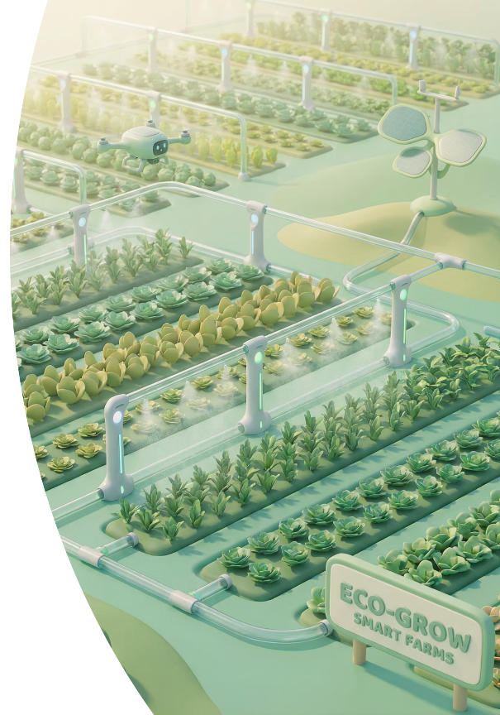
PRECISION AGRICULTURE
Precision Farming: Maximising Yields, Minimising Waste
Smart Irrigation Example
Optimised Input Application
IoT-enabled irrigation systems use real-time soil moisture sensors to schedule watering with unprecedented accuracy, delivering water only when and where crops need it.
Fertiliser and pesticide application is precisely calibrated to exact crop requirements based on continuous monitoring.
Eliminates overwatering and underwatering issues
Cuts input costs substantially
Significantly reduces overall water consumption
Reduces environmental impact
Maximises nutrient efficiency
Improves crop health and yield quality

Slide 7

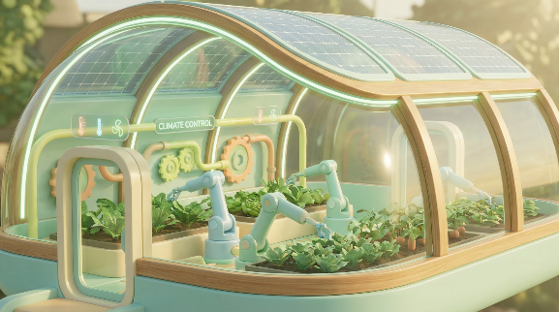
Livestock Monitoring & Smart Greenhouses
Connected Livestock Management
Intelligent Greenhouse Systems
IoT devices track animal health metrics, behaviour patterns, and location remotely, enabling early disease detection and improving overall welfare. Farmers receive instant alerts about animals requiring attention, optimising productivity whilst ensuring ethical treatment.
Smart greenhouses deploy solar-powered sensors to automatically control temperature, humidity, and lighting conditions. These systems extend growing seasons, reduce energy consumption, and create optimal environments for year-round production regardless of external weather conditions.

Slide 8
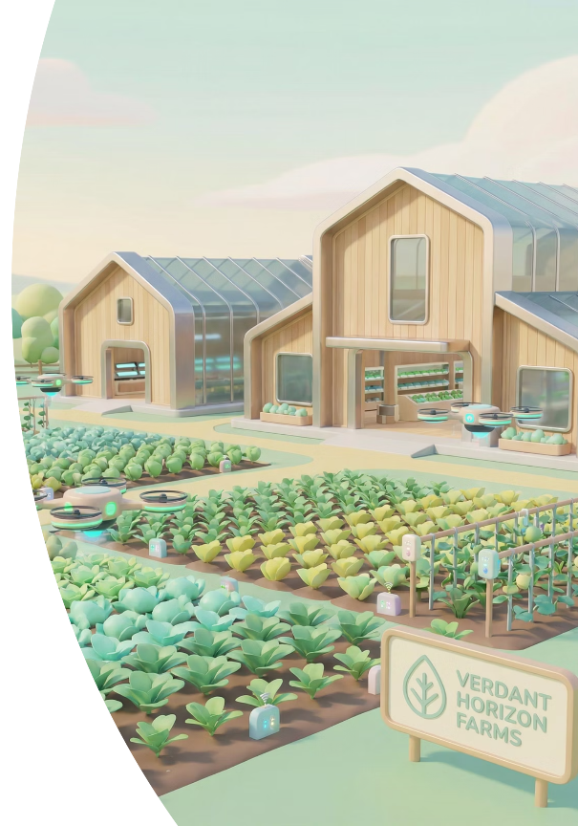




SUCCESS STORIES
Real-World Impact: Case Studies & Benefits
AI-Powered Optimisation
Advanced microservices optimise irrigation and fertigation schedules, dramatically reducing water and fertiliser waste whilst improving crop outcomes
Aerial Monitoring
Drones equipped with IoT sensors provide rapid, comprehensive crop health surveys, enabling early detection of pests and diseases
Farmer Empowerment
Farmers gain unprecedented control, reduce operational costs, increase yields, and promote environmental sustainability
Bottom Line: IoT technologies deliver measurable improvements in productivity, profitability, and sustainability across diverse farming operations worldwide.

Slide 9
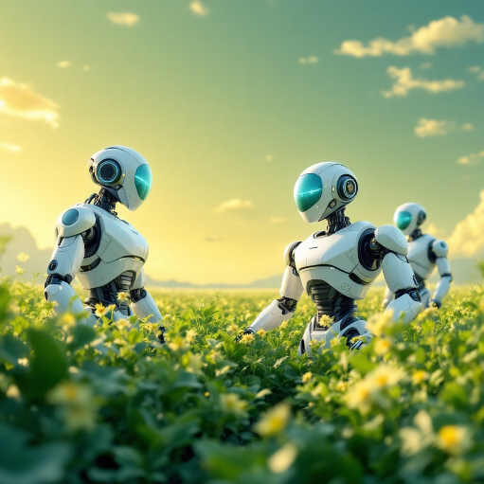
FUTURE OUTLOOK
Overcoming Challenges & Looking Ahead
Current Challenges
Tomorrow's Innovations
Rural Connectivity
Improving rapidly with deployment of low-power wide-area networks (LPWAN) specifically designed for agricultural applications
Data Security
Protecting sensitive farm data remains a priority as systems become more interconnected
System Integration
Ensuring seamless communication between diverse platforms and equipment manufacturers
The next generation of agricultural IoT will integrate with advanced robotics, digital twin technology, and sophisticated AI systems to create fully autonomous farms capable of self-optimising production.

Slide 10
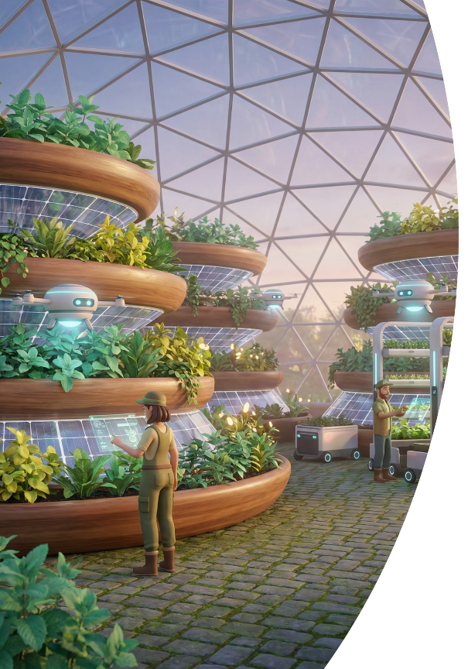



The Future of Farming is Connected
Agricultural Revolution
Feeding the World
IoT represents not merely a tool but a fundamental transformation in how we produce food sustainably for future generations
By embracing IoT technologies, farmers can meet the demands of a growing global population whilst conserving precious natural resources
Act Now
The time to invest in smart agriculture is now — transforming traditional fields into data-driven powerhouses of sustainable production

